Slide 1
Cyclistic Case Study
Presented by: Mahmoud El-Razzaz
Last Updated: September 14th, 2025

Slide 2
Table of contents
Project Overview – (What are we talking about?)
Peak Months – Seasonal trends in ride usage
Peak Days – Daily ride patterns
Peak Hours – Hourly ride patterns
Ride Length Distribution – How long users ride on average
Bike Type Usage – Popularity of classic vs electric bikes
Key Takeaways – Summary of insights
Recommendations – Actionable suggestions for Cyclistic

Slide 3
What are we talking about?

Slide 4
Objective
Analyse 12 months of Cyclistic bike-share data to understand how casual riders and annual members use the service differently.
Questions Being Answered: Which months, days, and hours have the most rides?
Audience / Purpose: Designed to inform Cylistic executive team about user behavior and trends.
Data Scope: Includes all rides from January to December, across multiple bike types and rider categories.

Slide 5
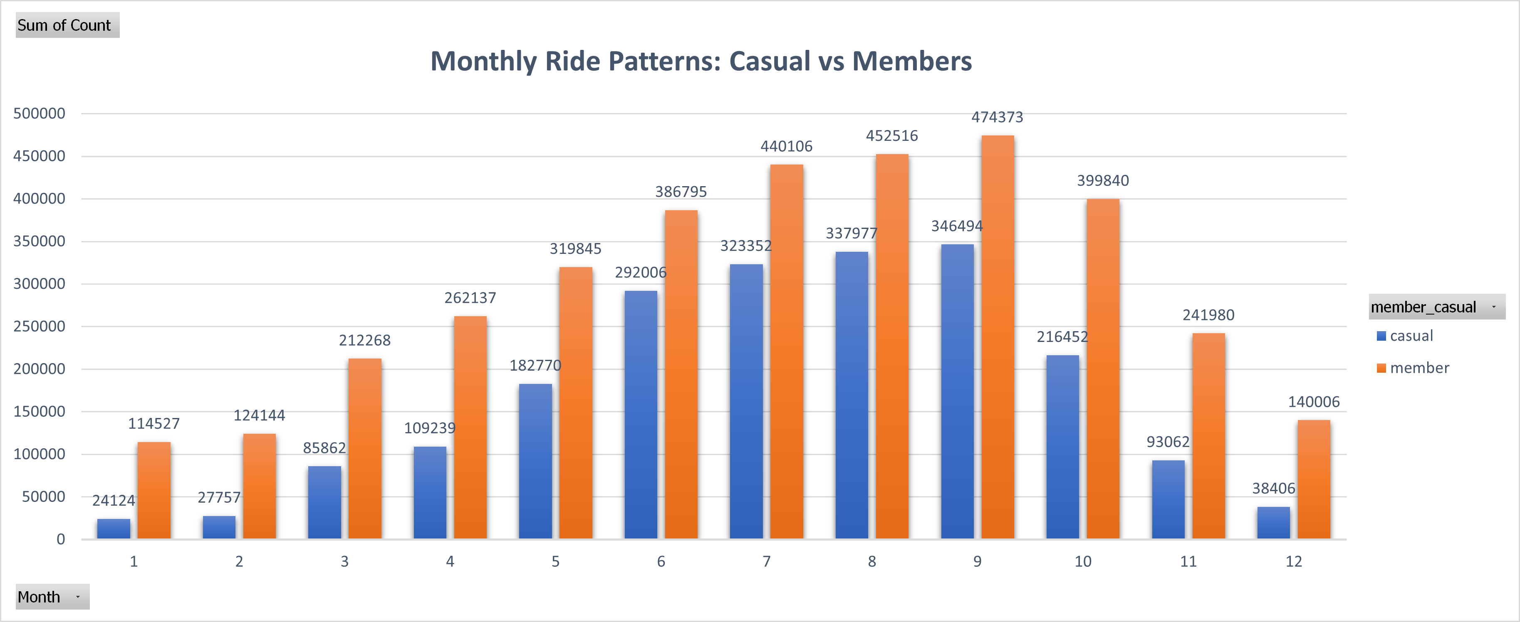
Peak Months
Peak months for both casual riders and members are July–September, likely due to summer activities and favourable weather.
More people ride in the summer months, likely because tourists and casual riders are on vacation or riding for fun.
Longer days in summer encourage more outdoor activities, leading to higher bike usage.

Slide 6
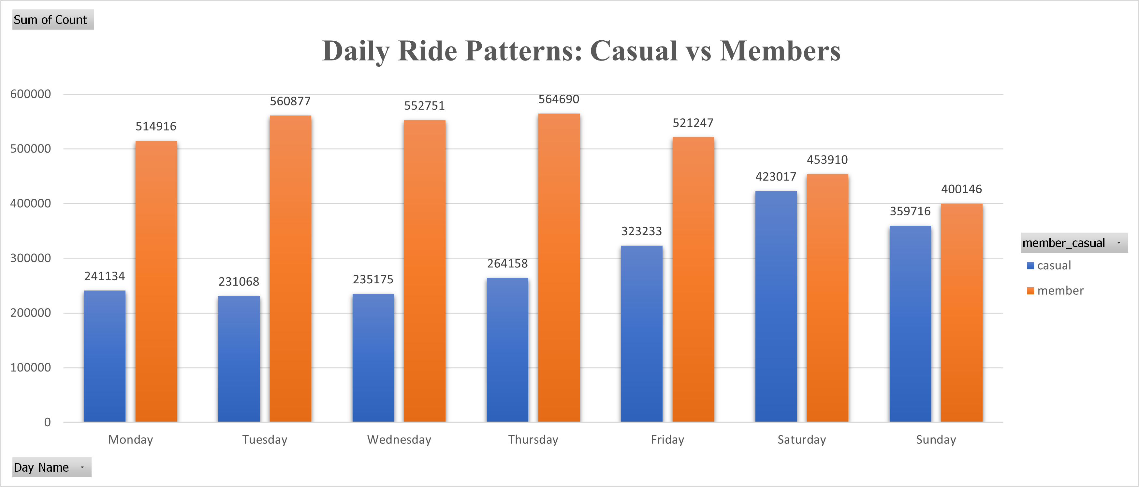
Peak Days
Annual Members busiest weekdays are Monday through Friday, reflecting regular commuting patterns.
Casual riders peak on weekends and holidays which is Saturday and Sunday because tourists and leisure users have free time.

Slide 7
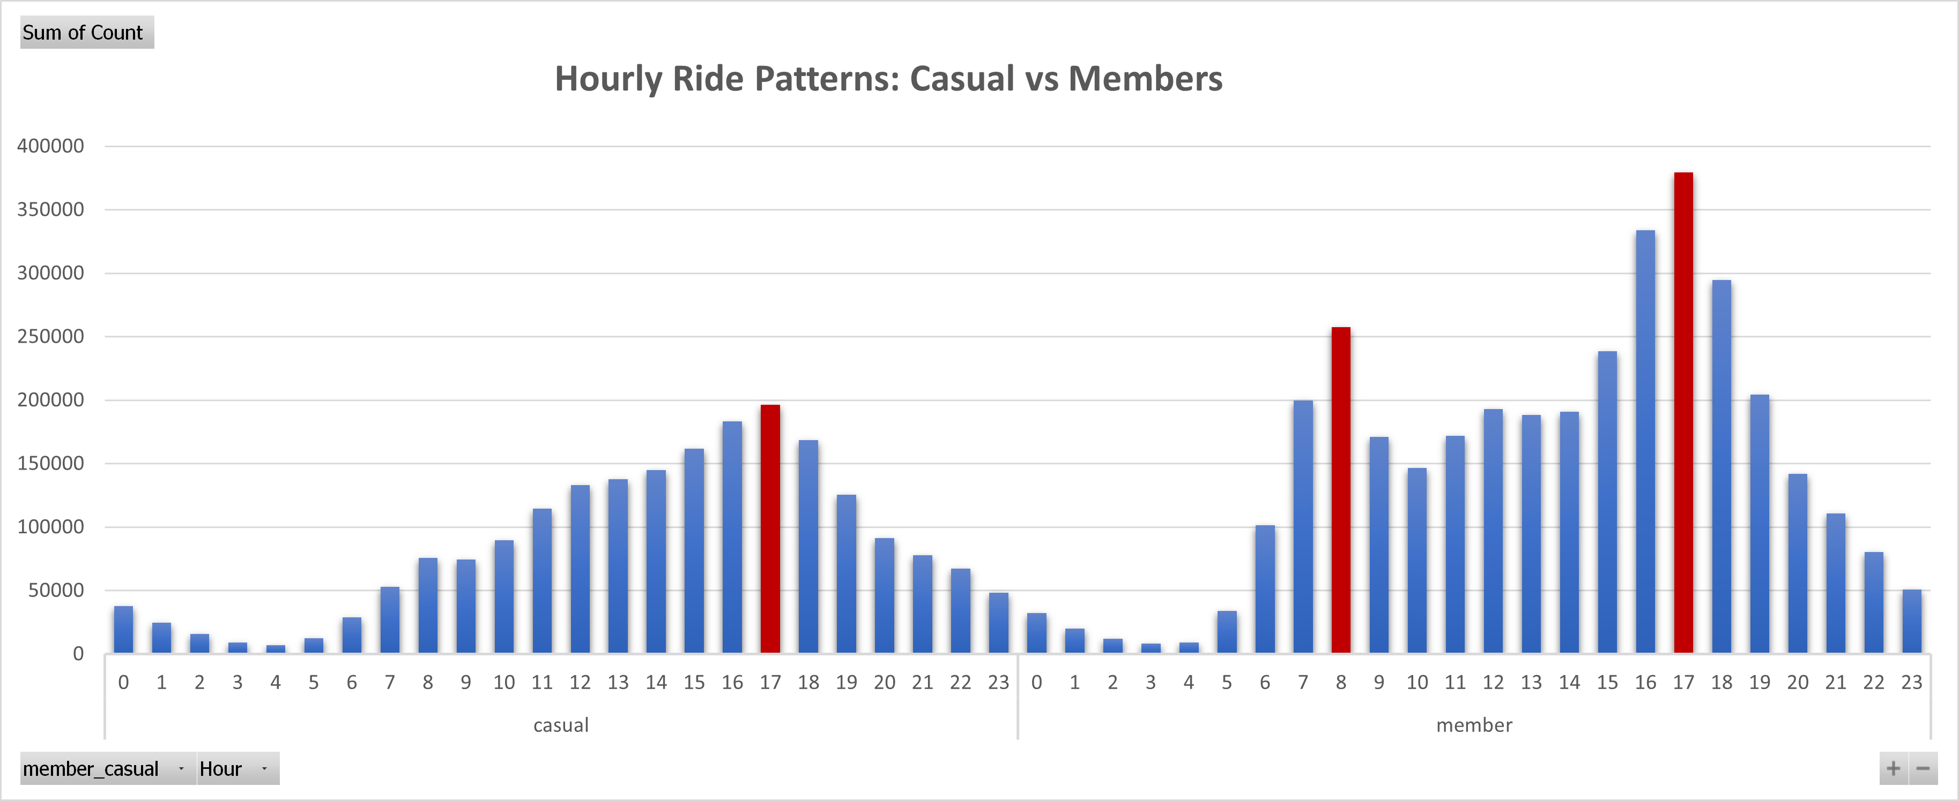
Peak Hours
Casual riders ride most around 17:00 or 5 P.M; likely because tourists and leisure riders enjoy afternoon trips.
Members peak at 08:00 or 8 A.M and 17:00 or 5 P.M, consistent with commute patterns.

Slide 8
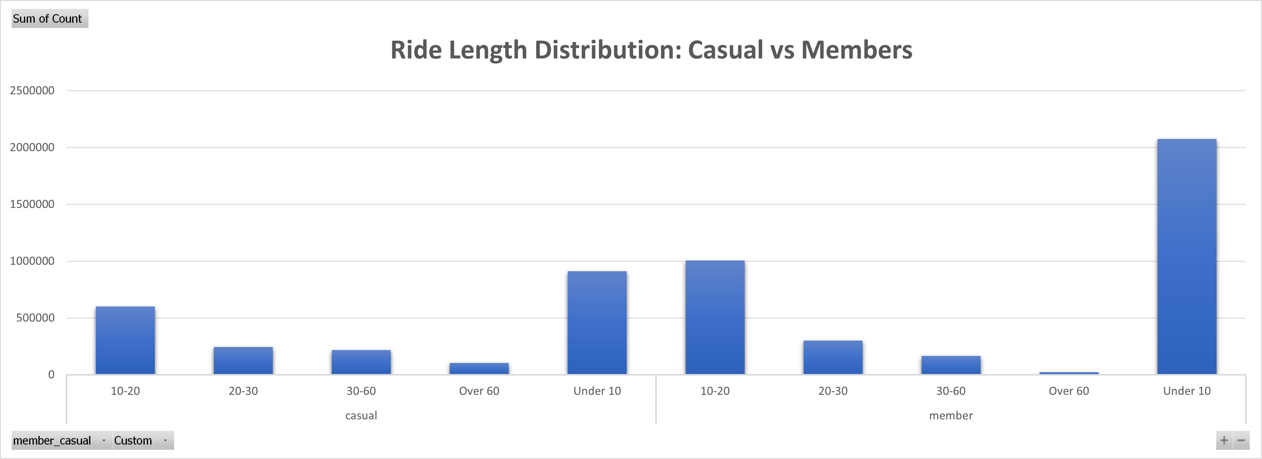
Ride Length Distribution
Most rides are under 10 minutes for both groups, with 10–20 minutes as the second most common.
Short rides dominate because people use bikes for quick trips or errands.

Slide 9
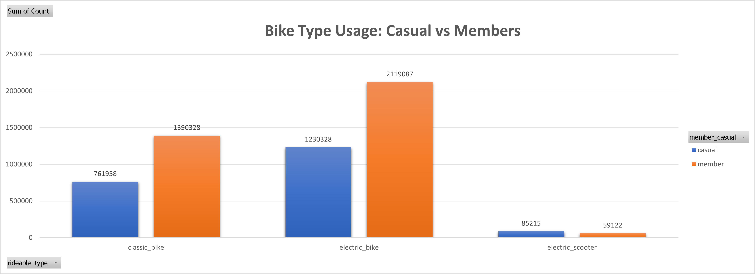
Bike Type Usage
Electric bikes are the most used for both casual and annual members.
Overall, electric bikes dominate usage, reflecting a shift toward more convenient and modern transportation options.

Slide 10
Key Findings: Summary
Rider Behaviour: Casual riders mostly ride for leisure on weekends and holidays; members ride mainly on weekdays for commuting.
Peak Hours: Casual riders peak around 5 PM (afternoon/evening fun), members peak at 8 AM and 5 PM (commute times).
Ride Length: Short rides dominate — under 10 minutes is the most common, followed by 10–20 minutes.
Bike Type: Electric bikes are the most popular choice; electric scooters are rarely used despite availability.
Trends: Overall, modern electric rides are increasingly preferred, and ride patterns reflect lifestyle differences between casual and annual members.

Slide 11
Recommendations
Offer seasonal subscriptions since most of Cyclistic casual riders are using bikes in summer specially July to September.
Weekend packages: Offer weekend-only passes or discounted Saturday/Sunday bundles to appeal to tourists and leisure riders.
Promote tourist-friendly offers near hotels, tourist areas, or via travel apps during peak summer months.
More data is needed to know proportion of local casual riders and visitors from other states, that will result in customizing specific membership programs or subscriptions.

Slide 12
Thank you
Project: Cyclistic Bike-Share Analysis
Created by: Mahmoud El-Razzaz
Google Data Analytics Certificate Capstone
Email: mahmoudhanirazzaz@gmail.com
LinkedIn: https://www.linkedin.com/in/mahmoudhanirazzaz/

